Slide 1
Capstone Project-1
EDA on Hotel Booking Analysis
Abhishek Kumar
Made By:

Slide 2
Contents:
Problem Statement
Work Flow
Data Description
Data Cleaning & Manipulation
Exploratory Data Analysis
Conclusions

Slide 3
Problem Statement
For this project we will be analyzing Hotel Booking data. This dataset contains booking information for city hotels & resort hotels and includes information such as:
> When the booking was made > The number of adults, children, and babies
> Length of stay > The number of available parking spaces
Hotel industry is a very volatile industry and the bookings depends on above factors and many more.
The main objective behind this project is to explore and analyze data to discover important factors that govern the bookings and give insights to hotel management, which can perform various campaigns to boost the business and performance.

Slide 4
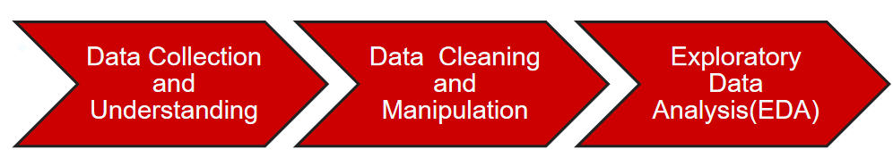
Work Flow
So we divide our work flow into following 3 steps.
EDA will be divided into 3 following 3 analysis.
Univariate analysis:- It is the Simplest of the three analyses where the data you are analysing is only one variable
Bivariate analysis:- It is where you are comparing two variable to study their relationship.
Multivariate Analysis :- It is similar to Bivariate analysis but you are comparing more than two variables.

Slide 5
Attributes Information hotel :Resort Hotel or City Hotel is_canceled : Value indicating if the booking was canceled (1) or not (0) lead_time : Number of days that elapsed between the entering date of the booking and the arrival date arrival_date_year : Year of arrival date arrival_date_month : Month of arrival date arrival_date_week_number : Week number of year for arrival date arrival_date_day_of_month : Day of arrival date stays_in_weekend_nights : Number of weekend nights stays_in_week_nights : Number of week nights.
Data Description
The dataset contains 119390 rows & 32 columns

Slide 6
adults : Number of adults children : Number of children babies : Number of babies meal : Type of meal booked. country : Country of origin market_segment : Market segment designation. (TA/TO) distribution_channel : Booking distribution channel.(T/A/TO) is_repeated_guest : is a repeated guest (1) or not (0) previous_cancellations : Number of previous bookings that were cancelled by the customer prior to the current booking previous_bookings_not_canceled : Number of previous bookings not cancelled by the customer prior to the current booking reserved_room_type : Code of room type reserved. assigned_room_type : Code for the type of room assigned to the booking.

Slide 7
booking_changes : Number of changes made to the booking from the moment the booking was entered on the PMS until the moment of check-in or cancellation deposit_type : No Deposit, Non Refund , Refundable. agent : ID of the travel agency that made the booking company : ID of the company/entity that made the booking . days_in_waiting_list : Number of days the booking was in the waiting list before it was confirmed to the customer customer_type : type of customer. Contract, Group, transient, Transient party. adr : Average Daily Rate as defined by dividing the sum of all lodging transactions by the total number of staying nights required_car_parking_spaces : Number of car parking spaces required by the customer total_of_special_requests : Number of special requests made by the customer (e.g. twin bed or high floor) reservation_status : Reservation last status

Slide 8
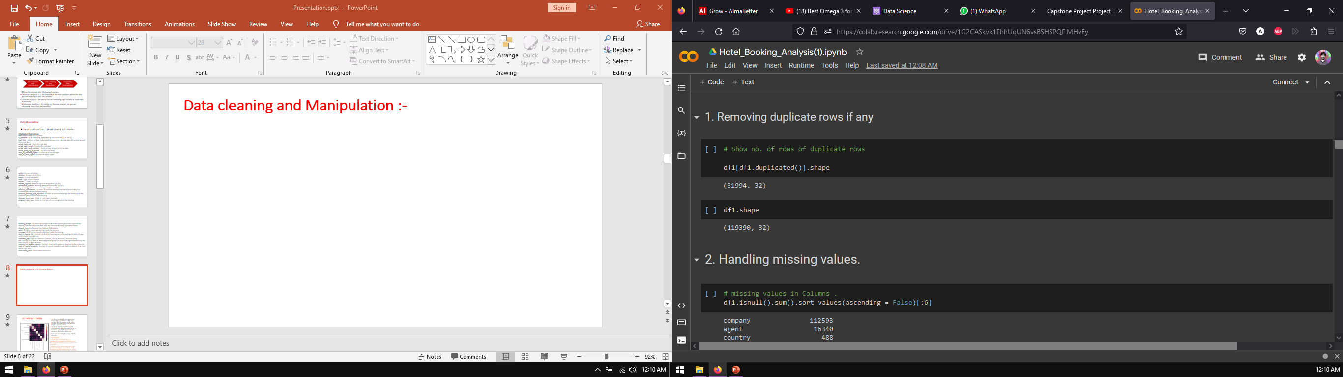
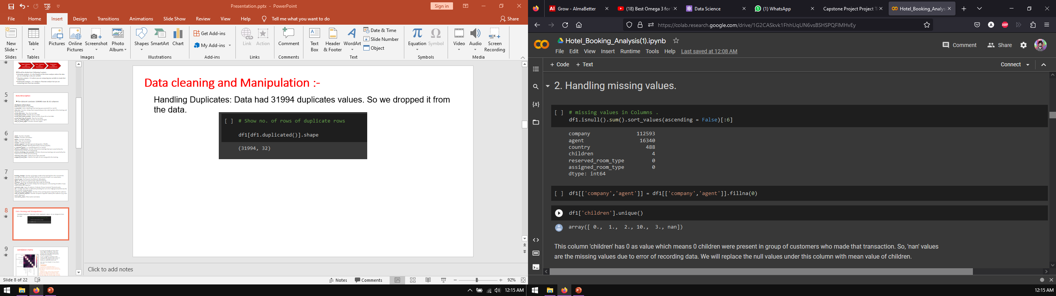
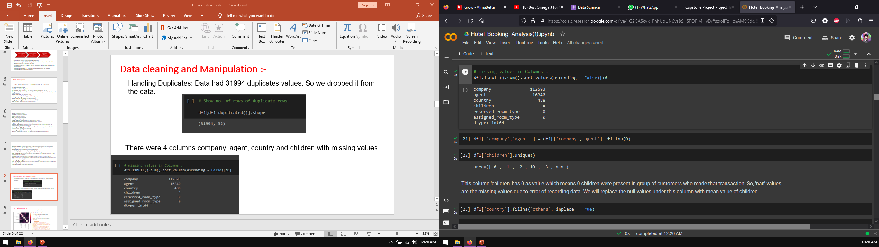
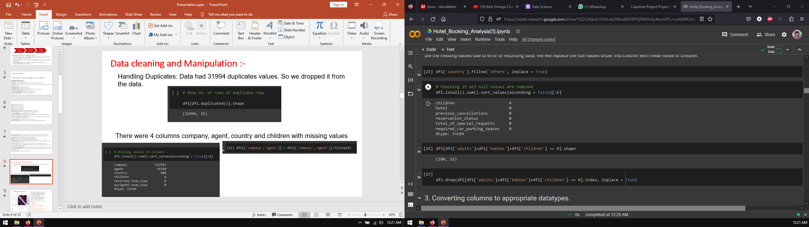
Data cleaning and Manipulation :-
Handling Duplicates: Data had 31994 duplicates values. So we dropped it from the data.
Handling Missing values
There were 4 columns company, agent, country and children with missing values

Slide 9
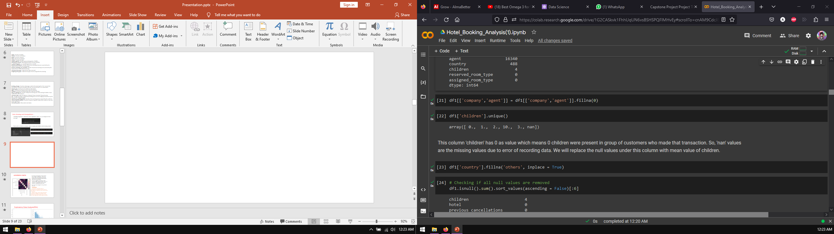
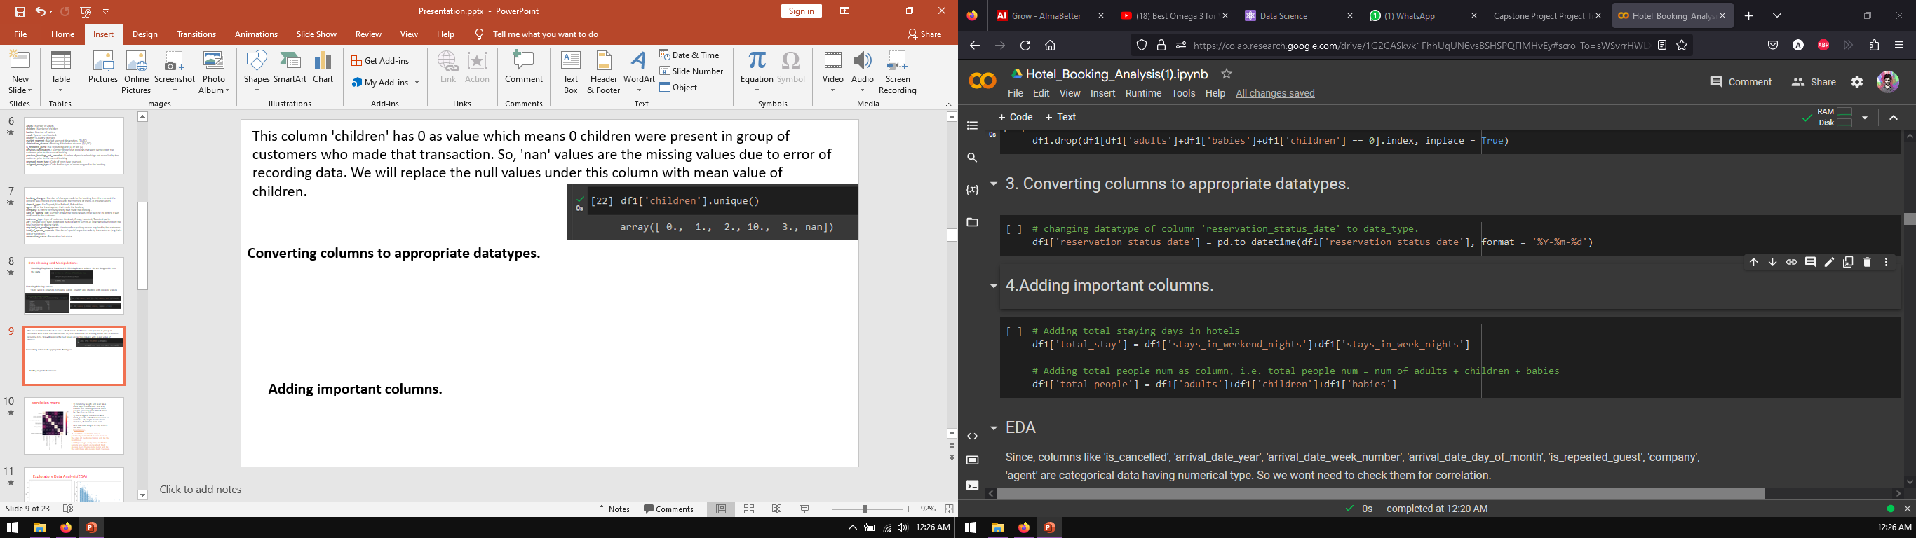
This column 'children' has 0 as value which means 0 children were present in group of customers who made that transaction. So, 'nan' values are the missing values due to error of recording data. We will replace the null values under this column with mean value of children.
Converting columns to appropriate datatypes.
Adding important columns.

Slide 10
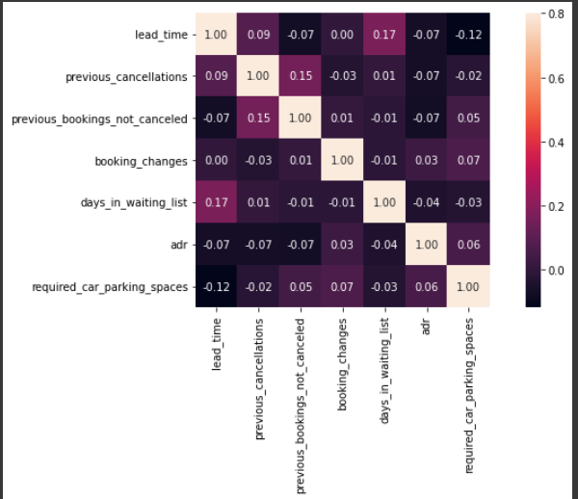
Correlation matrix
EDA
1) Total stay length and lead time have slight correlation. This may means that for longer hotel stays people generally plan little before the actual arrival.
2) adr is slightly correlated with total_people, which makes sense as more no. of people means more revenue, therefore more adr.
Lets see does length of stay affects the adr.
Conclusion:-
* Lead-time and total stay is positively correlated means more is the stay of customer more will be the lead time.
* ADR(average daily rate) and total people are highly correlated. That means more the people more will be the adr. High adr means high revenue.

Slide 11
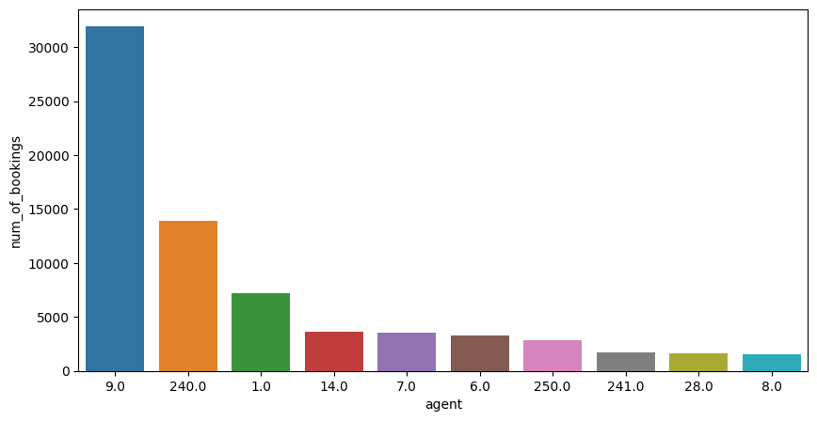
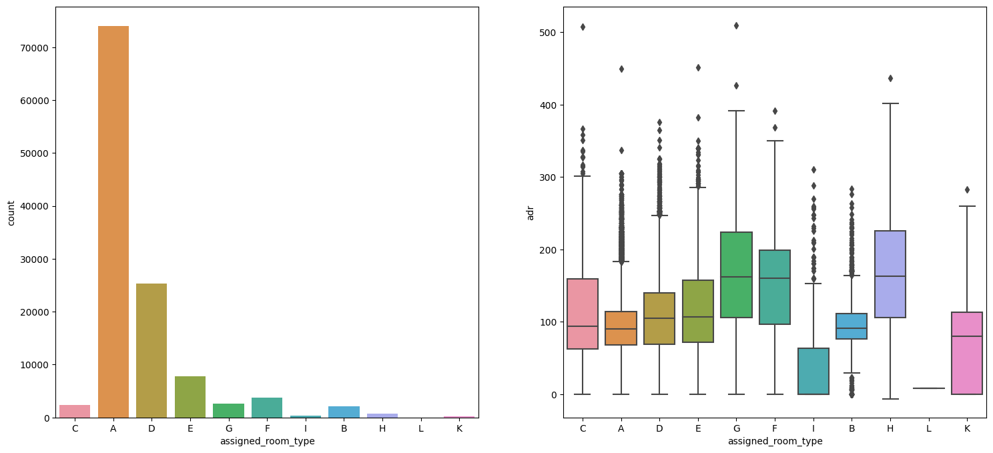
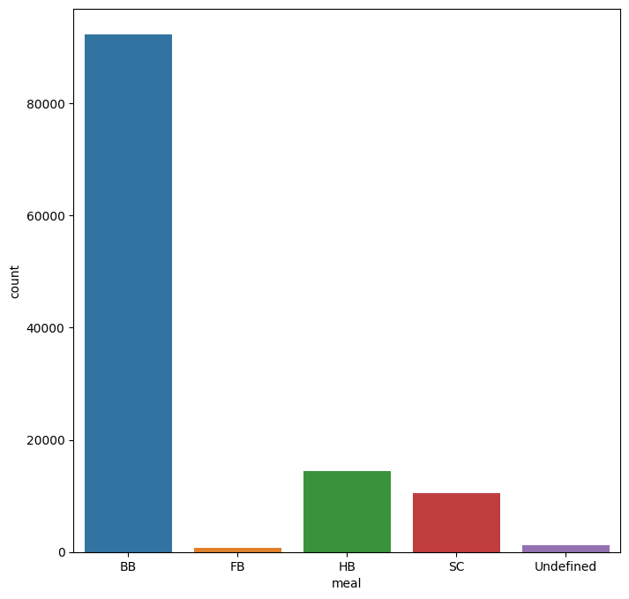
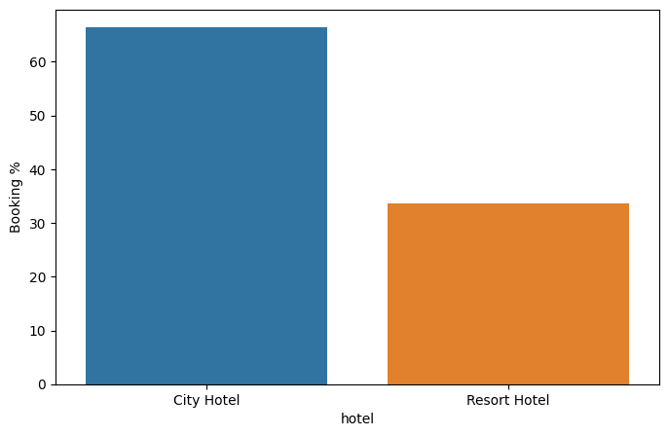
EDA
Number of bookings
Most demanding room and adr of different room types
Most preferred meal of customers
Percentage of bookings in each hotel

Slide 12
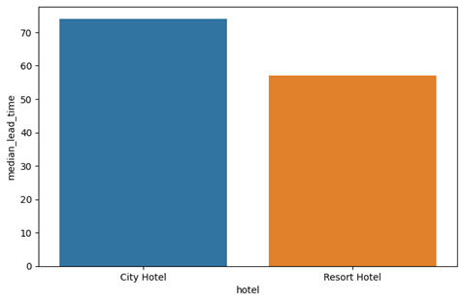
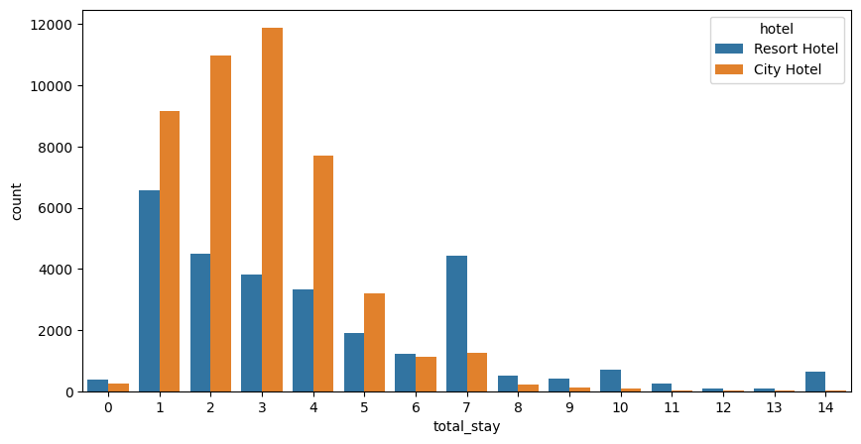
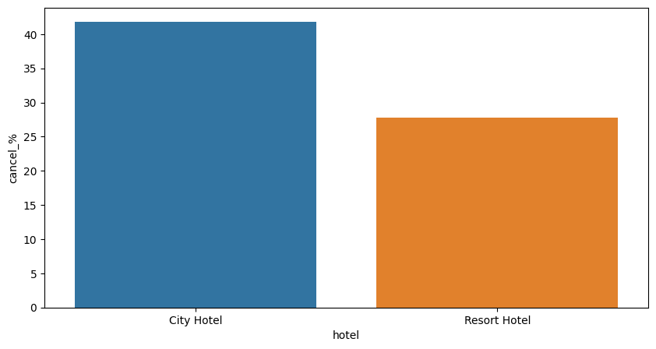
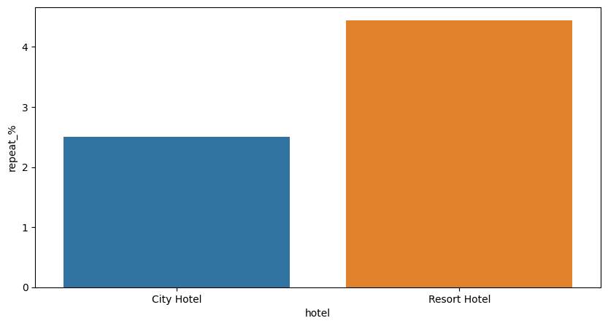
EDA
Lead time of hotels
Length of stay in each hotel
Bookings cancellation rate of hotels
Hotel customer returning for another stay

Slide 13
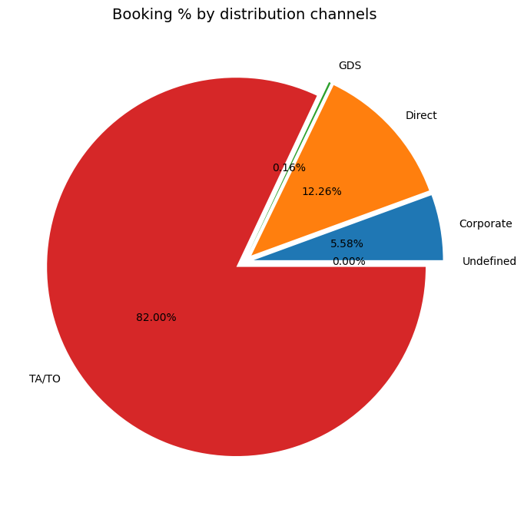
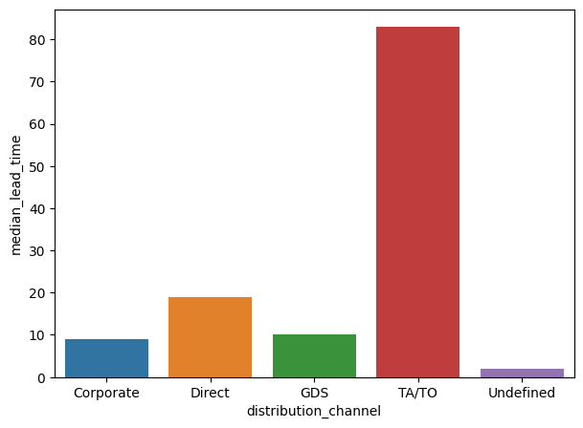
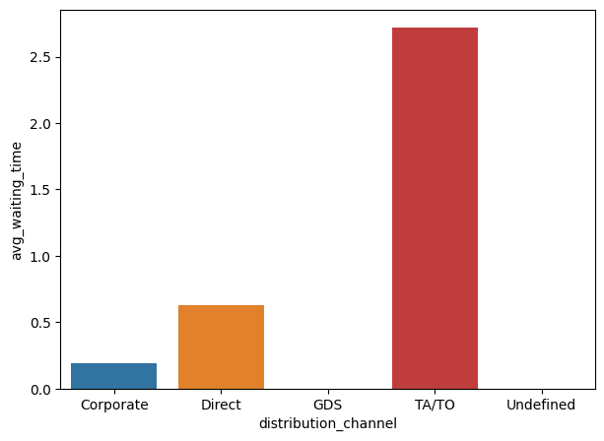
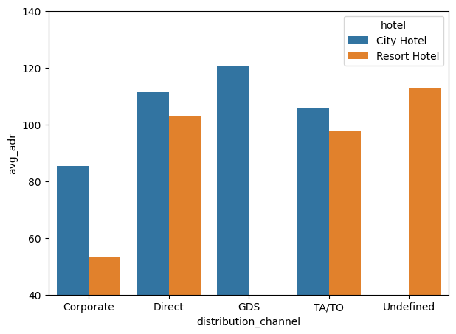
EDA
Channel and for early booking of hotels
Common channel for booking hotels
Revenue generating
deals for hotels by
distribution channel
Channel and average waiting time

Slide 14
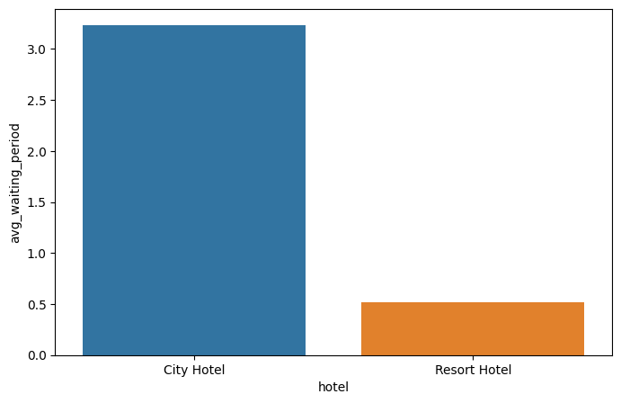
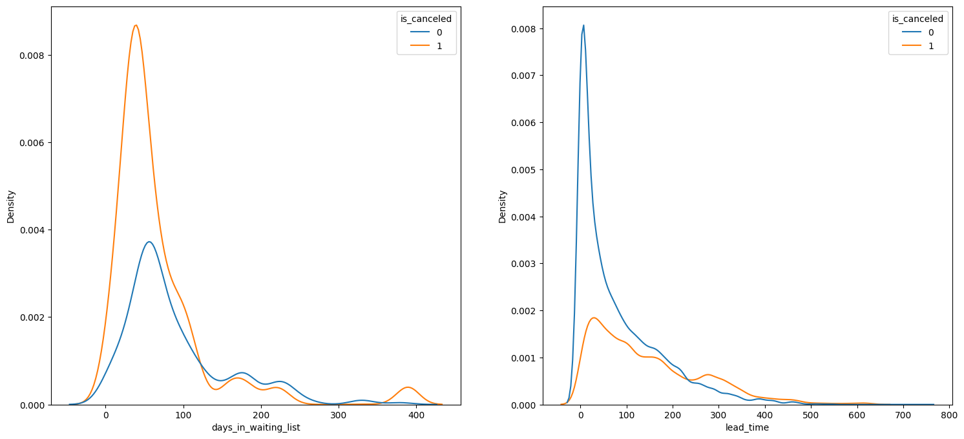
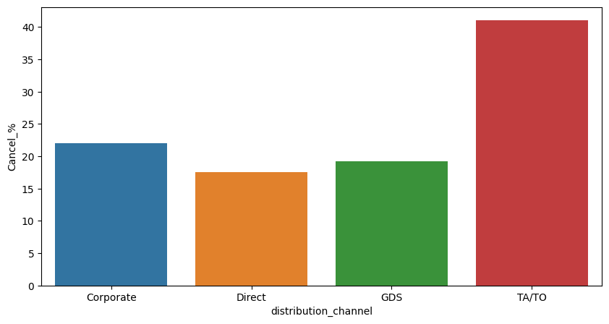
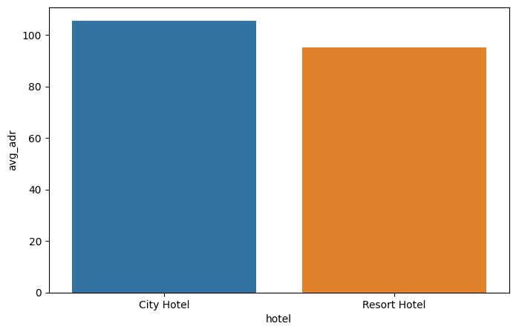
EDA
Hotels and waiting time
Selecting bookings with non zero waiting time
Channels and cancellation percentage
Hotels and revenue

Slide 15
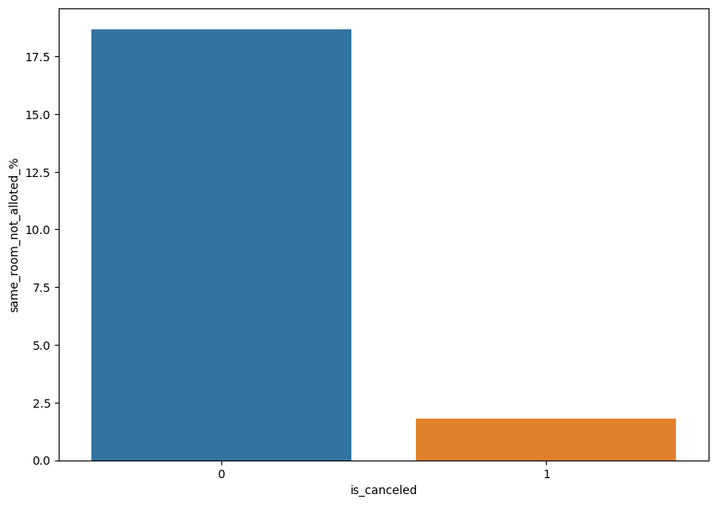
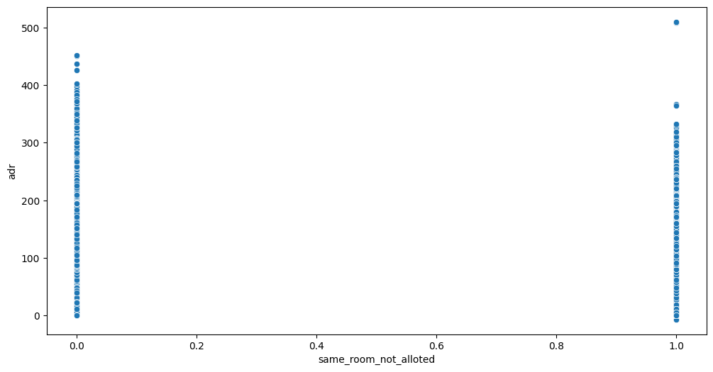
EDA
Not getting same room
Getting desired same room type is
cause of cancellation of bookings

Slide 16
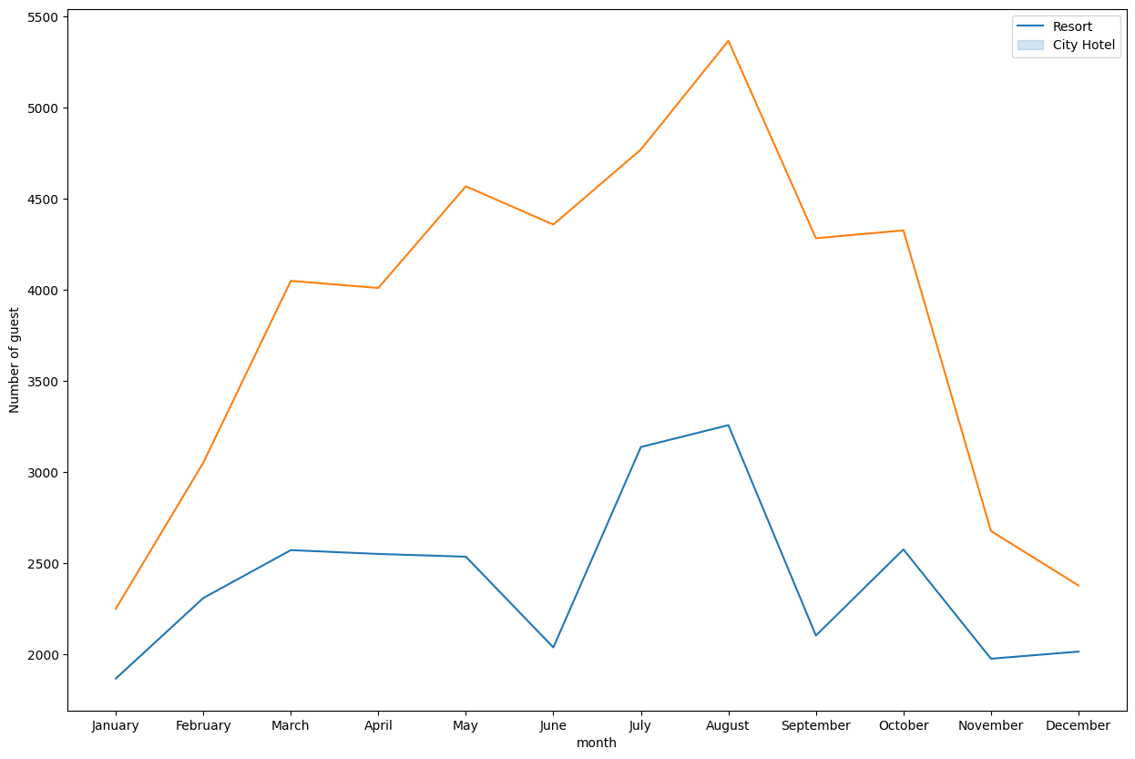
EDA
Month wise booking of hotels

Slide 17
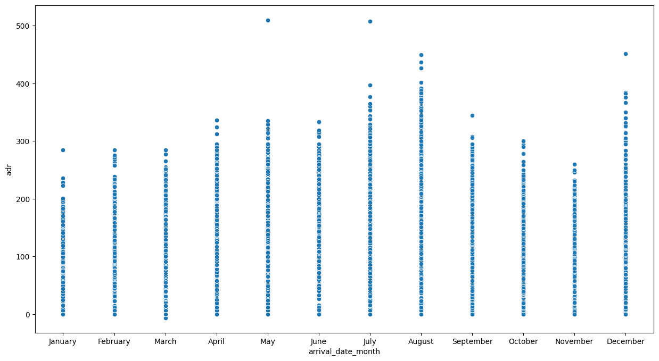
EDA
ADR month wise

Slide 18
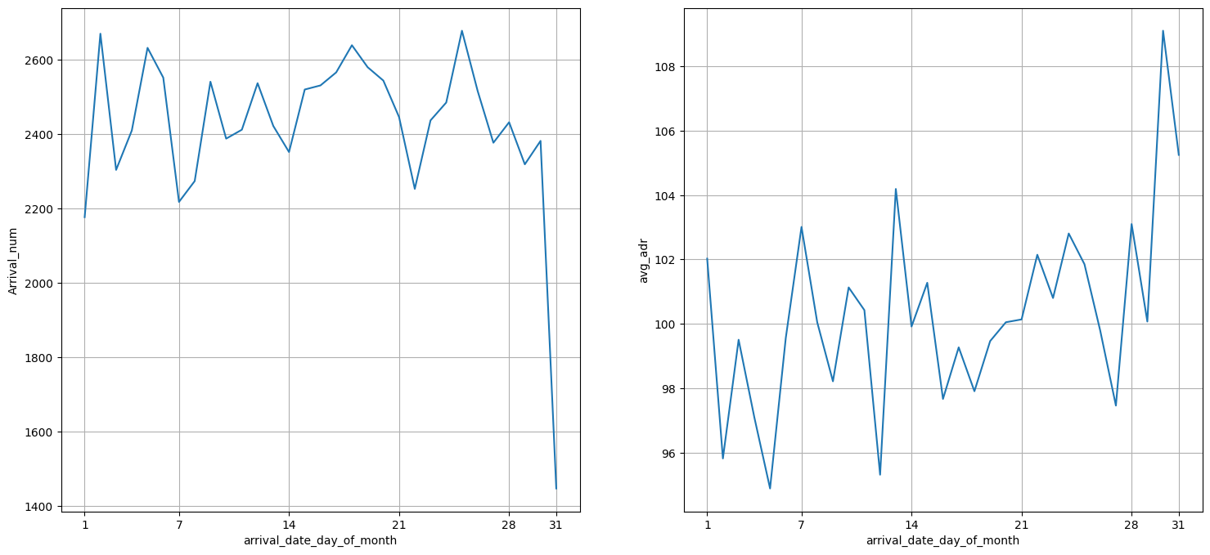
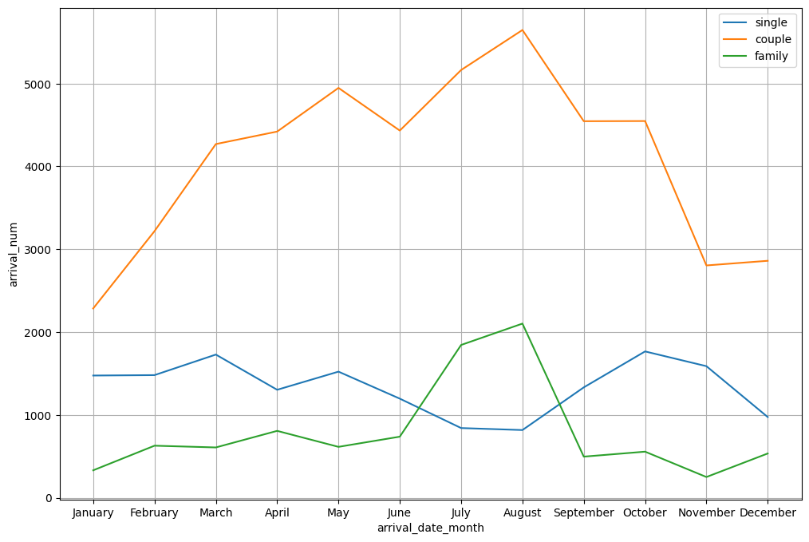
EDA
Customers are in three categories
single, couple and family/friends
Trend of arrival_num and
avg adr within a month

Slide 19
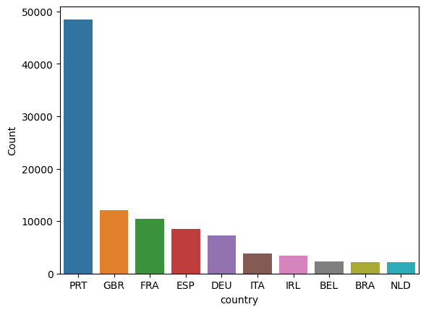
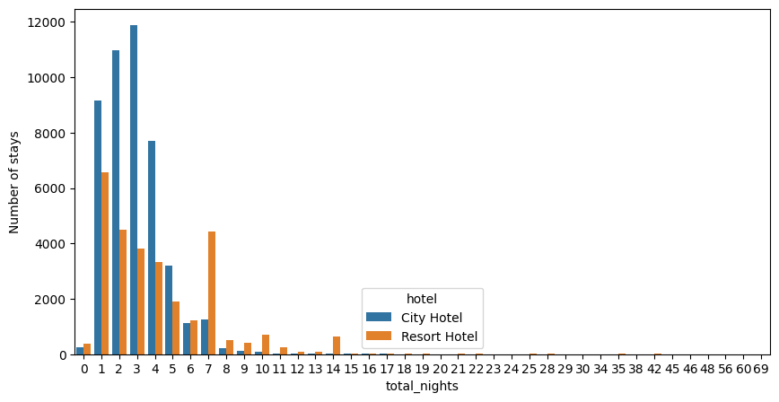
EDA
How long people staying at hotels
Guest and country

Slide 20
Conclusion:
* Total stay length and lead time have slight correlation. This may means that for longer hotel stays people generally plan little before the the actual arrival.
* adr is slightly correlated with total_people, which makes sense as more no. of people means more revenue, therefore more adr.
* Agent 9 have maximum bookings
* Most demanded room type is A, but better adr rooms are of type H, G and C also. Hotels should increase the no. of room types A and H to maximise revenue.
* Most preferred meal type is BB (Bed and breakfast).
* Around 60% bookings are for City hotel and 40% bookings are for Resort hotel.

Slide 21
Conclusion:
* City hotel has slightly higher median lead time. Also median lead time is significantly higher in each case, this means customers generally plan their hotel visits way to early.
* Most common stay length is less than 4 days and generally people prefer City hotel for short stay, but for long stays, Resort Hotel is preferred.
* Almost 30 % of City Hotel bookings got canceled.
* Both hotels have very small percentage that customer will repeat, but Resort hotel has slightly higher repeat % than City Hotel.
* TA/TO is mostly used for planning Hotel visits ahead of time. But for sudden visits other mediums are most preferred.

Slide 22
Conclusion:
* While booking via TA/TO one may have to wait a little longer to confirm booking of rooms.
* GDS channel brings higher revenue generating deals for City hotel, in contrast to that most bookings come via TA/TO. City Hotel can work to increase outreach on GDS channels to get more higher revenue generating deals.
* City hotel have high waiting time than resort hotels
* City hotel have more revenue than resort hotel with less difference
* TA/TO has highest booking cancellation %. Therefore, a booking via TA/TO is 30% likely to get cancelled.

Slide 23
Conclusion:
* We see that most of the bookings that are cancelled have waiting period of less 150 days but also most of bookings that are not cancelled also have waiting period less than 150 days. Hence this shows that waiting period has no effect on cancellation of bookings. Also, lead time has no affect on cancellation of bookings, as both curves of cancelation and not cancelation are similar for lead time too.
* We see that not getting same room as desired is not the case of cancellation of rooms. A significant percentage of bookings are not cancelled even after getting different room as desired.
* not getting same room affects the adr, people who didn't got same room have paid a little lower adr, except for few exceptions.
* Most number of guests comes in month of August.

Slide 24
Conclusion:
* Avg adr rises from beginning of year upto middle of year and reaches peak at August and then lowers to the end of year. But hotels do make good deals with high adr at end of year.
* We can see that graph Arrival_num has small peaks at regular interval of days. This can be due to increase in arrival weekend. Also the avg adr tends to go up as month ends. Therefore charge more at the end of month.
* Moslty bookings are done by couples(although we are not sure that they are couple as data doesn't tell about that)
* It is clear from graph that their is a sudden surge in arrival num of couples and family in months of July and August. So better plans can be planned accordingly at that time for these type of customers.
* Most people prefer to stay at the hotels of <=5 days.

Slide 25
Thank you

